Slide 1

Requirements Analysis
Going from “what” to “how”
Notes:
‹#›

Slide 2
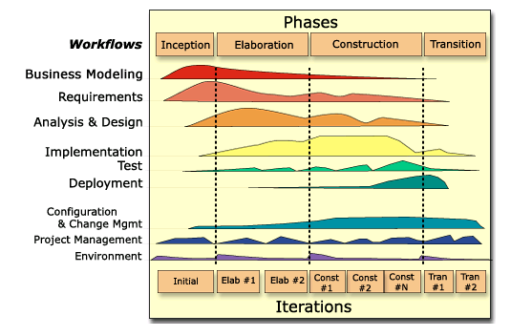
Where are we?
RUP phases and core workflows:
We are here!

Slide 3
The Requirements Baseline
A Requirements Baseline means we have established, in the users language, a statement of the system functionality and operating constraints
Business
Vision /
Roadmap
Everybody depends on it!
Project Plans
Informal
Requirements
SRS
Requirements
Analysis
Feasibility/Cost
Analysis
Contract(s)
Users
Customers
Business
Stakeholders
Requirements
Analysts
QA
Architect

Slide 4
Requirements Analysis Overview
Requirements vs. Design
Comes down to “what” vs. “how”
In practice, your are placed under constraints from other stakeholders as to “how” - design constraints
“restrictions on the design of a system, or the process by which a system is developed, that do not affect the external behavior of the system but that must be fulfilled to meet technical, business, or contractual obligations” (L&W, p. 241)
Requirements Analysis
a collection of activities whose objective is to provide a communicative model to bridge the chasm between business stakeholders and implementers.
Many do not see the value, or consider as part of requirements specification!

Slide 5
Analysis, Architecture, and Design
Problem:
How do we take requirements, expressed as the needs of a software system in a domain, and translate them into software products?
Answer (version 1):
We give the requirements to our programmers and let them have at it!
Requirements
“Some amount of
Magic happens…”
Code

Slide 6
Analysis, Architecture, and Design
Answer (version 2):
We create abstractions that allow us to map the complexity of the requirements to the space of software design
Start with high-level analysis (initial design)
Uncover architectural components and patterns
Do more detailed design of each component
Requirements
“Let’s follow a
top-down method”
Code

Slide 7
Analysis, Architecture, and Design
Answer (version 3):
“Instead of expending a lot of energy modeling the world, let’s rapidly build solutions to smaller, well-defined problems and integrate the results as we go up”
“Let’s follow a
Bottom-up approach
first and integrate later”

Slide 8
Analysis, Architecture, and Design
Answer (version 4):
“I want to do structured analysis and design, but I have a legacy set of components that I need to leverage as part of the solution.”
analysis model
Maps into
legacy
components

Slide 9
Example methods
A LOT of analysis methods and notations exist
ER, DFD, Activity diagrams, Statecharts, OOA&D, UI analysis, stimulus-response, Petri nets, IDEF, PDL, Data Dictionaries, Zed, Jackson System Design (JSD), Axiomatic specifications, grammars, predicate logic, Event tables, MDA, Warnier diagrams, …
Prevaling wisdom is that many models may be needed to express multiple perspectives
Examples:
RUP 4+1 view of system architecture, analysis models
Structured Analysis Method (SAM): Data, Behaviors, Flow
XP: YAGNI!

Slide 10
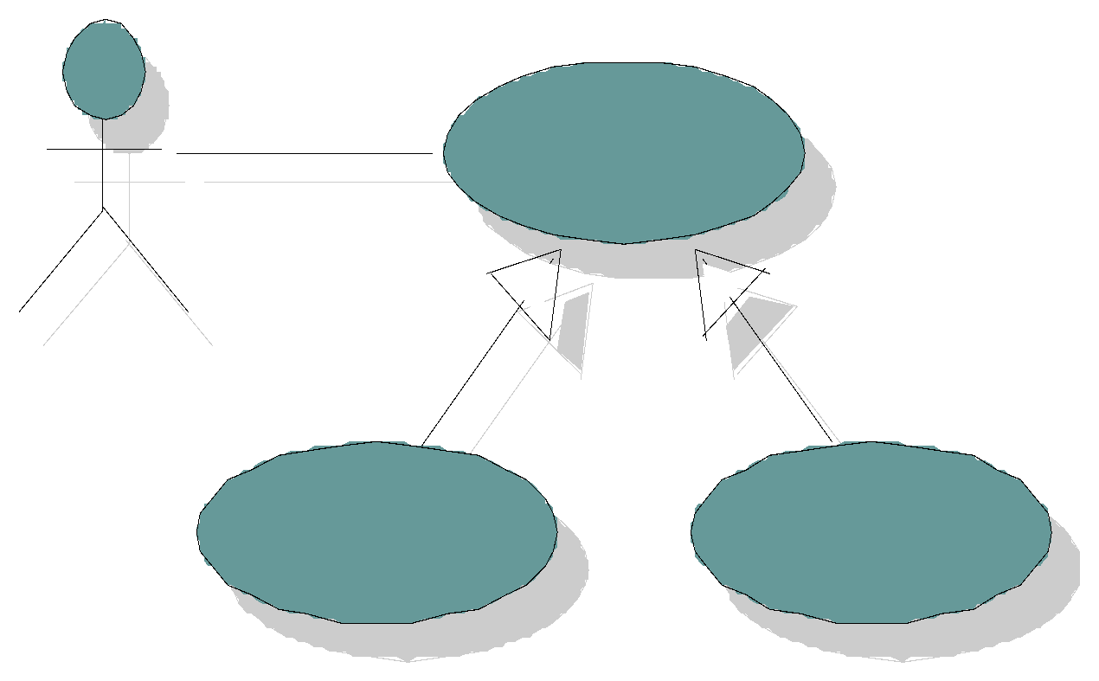
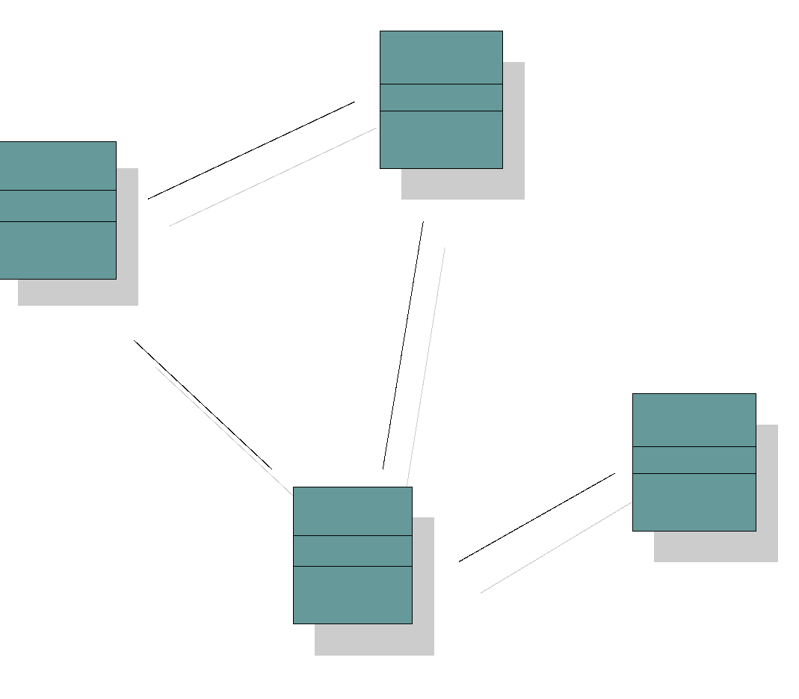
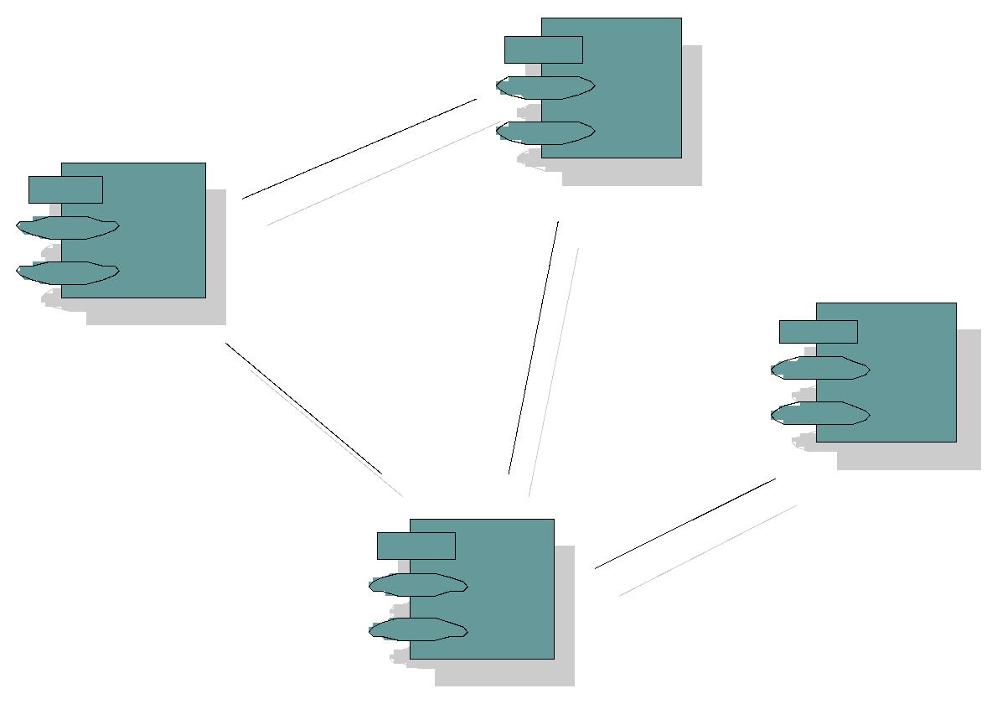

RUP 4+1 View Model
Logical View
Implementation View
Analysts/Designers
Structure
End-user
Programmers
Software management
Functionality
Use-Case View
Process View
Deployment View
System integrators
System engineering
Performance
Scalability
Throughput
System topology
Delivery, installation
communication
An architectural view is an abstraction of a system from a particular perspective covering particular concerns, and omitting entities that are not relevant to this perspective. Views are “slices” of models

Slide 11
Analysis Methods Taxonomy
Catalog of analysis modeling techniques:
Data/object models:
Captures data in the given domain and relationships between them.
Examples: Entity-Relationship, OOA&D, Data Dictionaries
Behavioral models:
Captures system behaviors, states, and state transitions
Examples: Use case models, statecharts, S-R
Flow models:
Captures functional task flows and/or dataflows
Examples: Process/workflow models (IDEF0), Dataflow diagrams (DFD), Sequence/Collaboration diagrams, Activity diagrams
What about methods?
SAM, RUP, JSD
RUP example at end

Slide 12
Data Model Example: ER
Description:
“At Arizona State University, faculty members teach many students. Each faculty member has a unique employee tax ID, a rank, an assigned academic unit, name, email, and phone number. Each student has a unique ASU ID number, a name, a year in school, a degree program, and an email address. A faculty member teaches a student over the course of a given semester, identified by term and year (example: Fall 2010).”
(0,n)
teach
(1,n)
Faculty
Student
TaxID
Name
rank
unit
email
ASUID
Name
Year
Degree
email
Fname
Lname
Fname
Lname

Slide 13
Behavioral Example: State Machines
Faculty Members
“Flat” SM
Hired
accepted
Assistant
Professor
Apply for Job
Add Applied State
Applied
H
maxPapers
Tenured
Which position?
Add Superstate
Add History
rejected
seniority
retired
Professor
Faculty on Sabbatical
Add external transition
Add History
H
takeSabbatical
return
Hiatus
Tie up Lifecycle
Add final state

Slide 14
Flow Example: Dataflow Diagram
New
Image
Image
Convert
Image
Pixel count
Filter
Histogram
Data that comes from outside the system is called a source. A sink is where data goes - a destination
A conversion of data from one form to another - a processing element.
Direction data travels, possibly with some indication of which data
A place to put transient data for later use by the system
Information
Source or Sink
Data
Transform
Information Flow
Information Store

Slide 15
RUP Analysis: Use-Case Realization
Use-Case Model
Design Model
Use Case
Use-Case Realization
Sequence Diagrams
Collaboration Diagrams
Use Case
Class Diagrams
Object Oriented Analysis and Design Using the UML v2000
Copyright © 2000 Rational Software, all rights reserved

Slide 16
Example: RUP Analysis Classes
The complete behavior of a use case has to be distributed to analysis classes
Does not have to be of
one of these stereotypes
Focus on identifying responsibilities, not interface or method definitions
<<boundary>>
System boundary
<<control>>
Use-case behavior coordination
System information
<<entity>>

Slide 17
Observation
Also called “ethnography”
Modality:
1-way communication
Real-time vs. video capture vs. event capture
Staged environment versus real environment
How-to:
Determine modality – will you observe live or capture via video or some other technology
Review organizational & regulatory policies, NDAs, etc.
Prepare a debriefing memo
Determine a recording format and method
Embed into environment with minimal intrusion

Slide 18
Observation
Pros:
Observing how customer works allows you to see how the technology benefits.
Removes the 0th-order interpreter – the user
Cons:
Time-consuming
Observee will not behave “naturally” (Hawthorne effect)
Disruption to the workplace
To Note:
Ethnography is a well-known elicitation technique in research circles, and may be suitable for inception
Requirements elicitation using ethnography is often too time-consuming, too disruptive – simply too awkward

Slide 19
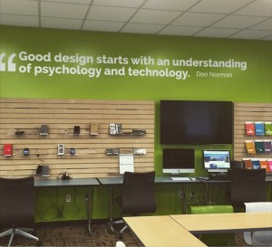

Observation
To Note (cont):
A variant on embedded observation is a
staged observation for HCI evaluation
Observe a user interacting with the system
Video
Event tracking (mouse clicks, screen visit sequence, etc.)
Not really “ethnography”
Part of “User-centered design” when designing a HCI
Another variant on Observation is Apprenticing
The users train the Business Analyst on how to do the job
BA then performs in that role for some time to learn first-hand the issues for end users
Time-consuming but very effective

Slide 20
Joint Application Design
Modality
Multi-way: customers, users, designers, and experts
A cross between group meetings and prototypes
Similar to evolutionary style of concurrent development, except the stakeholders are part of the development team
How-to:
Carefully assemble a team
Ensure roles are blurred – everyone is a peer and everyone’s opinions are important. Design is not just for the designers
JAD sessions require a clear statement of the purpose of the session and its goals.
JAD sessions are usually run by a facilitator who keeps the participants focused.
Can have observers, but observers must remain silent according to the rules of JAD.

Slide 21

Joint Application Design
Pros:
Workshop-type feel facilitates participation
All stakeholders feel ownership and teamwork
All concerns laid out on the table
Cons:
Requires a skilled facilitator
Social issues – some individuals may dominate
Consensus building can be difficult in a large group

Slide 22
Elicitation Issues
“Yes, but…”
Issue: Software is “Infinitely malleable”, so users continue to add/morph features. A scope issue!
Solution: Make the software “real” (prototype).
“Undiscovered Ruins”
Issue: “the more you find the more that remain”
Solution: Iterate!
“User and Developer”
Issue: Communication gap between the two
Solution: Burden is on the solution provider! Use multiple techniques, reviews, and checks.
“Over-reliance on Interviews”
Issue: Interviews the most obvious thing to do
Solution: Employ the full range of techniques here, and have a plan and internal retrospectives of how elicitation is doing on your project.
These ideas from Leffingwell & Widrig, but you should also read the 2003
Hickey & Davis paper “Elicitation Technique Selection: How Do Experts Do It?” and at least
the intro of Carrizo et. al. 2014 “Systematizing requirements elicitation technique selection”

Slide 23
Requirements Elicitation Summary
Elicitation and the Requirements Workflow
Your deliverable is “uncovered” knowledge
Format may or may not be important
We are assuming not important yet. Natural language is fine
The responsibility of the BA
Next steps involve documenting, organizing, prioritizing requirements
Reminders:
This is a “soft science” – there is no recipe for success
Iterate with the customer until you get convergence
Cross-check results with multiple people and methods
Understand what is volatile and what is enduring early!
Do not burn the customer out! Do not burn yourself out!
Do not over-commit or ask the customer to over-commit!

